Slide 1
Reinforcement Learning Based Query Vertex Ordering Model for Subgraph Matching
Hanchen Wang, Ying Zhang, Lu Qin, Wei Wang, Wenjie Zhang, Xuemin Lin

Slide 2
Background
Motivation
Framework
Feature Representations
Query Vertex Ordering as Markov Decision Process
Policy Training
Experiments

Slide 3
Subgraph Matching
The objective of the subgraph matching is searching for all subgraph isomorphisms from query graph q to data graph G

Slide 4
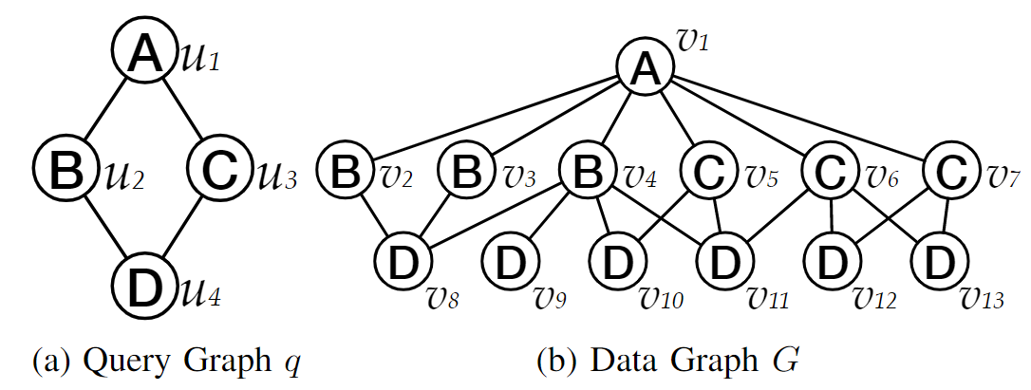
Subgraph Isomorphism
Notes:
There is a very simple example about the subgraph isomorphism. We have the query graph q with vertices u1 to u4 and the data graph G with the vertices v1 to v13.

Slide 5
Subgraph Isomorphism
Notes:
This is the first possible subgraph isomorphism from q to G where u1 maps to v1, u2 maps to v4, u3 maps to v5 and u4 maps to v10.

Slide 6
Subgraph Isomorphism
Notes:
This is the second mapping and u4 maps to v11.

Slide 7
Subgraph Isomorphism
Notes:
This is the third mapping, where u3 maps to v6.

Slide 8
Existing Subgraph Matching Methods
There are two major categories of subgraph matching methods:
Backtracking-based methods
Join-based methods
In this work, we focus on the backtracking-based methods.

Slide 9
Existing Subgraph Matching Methods
The backtracking-based methods can be partitioned in three main phases:
The complete candidate vertex set generation.
Matching order generation.
Matching enumeration.

Slide 10
Backtracking-based Methods
Complete candidate vertex set generation is to filter out the unpromising vertices, and hence reduce the search space before the enumeration process begins.

Slide 11
Backtracking-based Methods
Matching order generation phase generates the matching order φ to guide the enumeration of matched subgraphs.

Slide 12
Backtracking-based Methods
The enumeration procedure finds all matches of the query subgraph q in the data graph G with given matching order φ.

Slide 13
Subgraph Matching
Subgraph matching has wide applications such as query in graph database and biological graph analytics.
However, it has been proven that the subgraph matching is NP-complete. We cannot optimize the worst-case time cost.
In this work, we aim to reduce the enumeration time on the average case by proposing a novel query vertex ordering method.

Slide 14
Background
Motivation
Framework
Feature Representations
Query Vertex Ordering as Markov Decision Process
Policy Training
Experiments

Slide 15
Limitations of Existing Order Generation Methods
The existing subgraph matching methods usually generate the matching order based on the heuristic values, here are some examples:
Infrequent edge first ordering
Infrequent label first ordering
Path-based ordering.
Notes:
The motivation of this work comes from the limitations of the existing order generation methods. The existing subgraph matching methods xxx.

Slide 16
Limitations of Existing Order Generation Methods
Two major limitations:
Cannot fully use the graph information.
Greedy heuristics can lead to local optimum.
Notes:
However, these methods usually have the following limitations:

Slide 17
If ordering based on degree (RI)
Degree: 2
Degree: 2
Degree: 2
Degree: 2

Slide 18
If ordering based on label frequency
LF: 1/13
LF: Label frequency
LF: 3/13
LF: 3/13
LF: 6/13

Slide 19
Greedy heuristics can lead to local optimum
The heuristic-based greedy methods can reduce the most redundant intermediate results.
However, these methods cannot consider the long-term query time cost.
The exact optimal order can only be found after all possible order permutations are evaluated.

Slide 20
Our solutions
Motivated by the aforementioned limitations, we proposed the following approaches:
Capture the graph information with graph neural network.
Try to approach the global optimal with reinforcement learning.

Slide 21
Background
Motivation
Framework
Feature Representations
Query Vertex Ordering as Markov Decision Process
Policy Training
Experiments

Slide 22
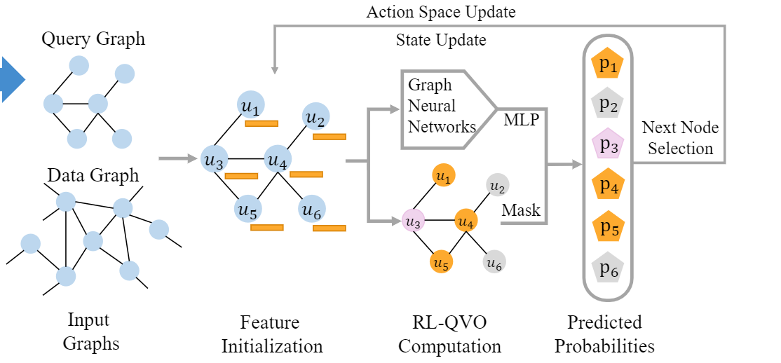
Framework

Slide 23
Background
Motivation
Framework
Feature Representations
Query Vertex Ordering as Markov Decision Process
Policy Training
Experiments

Slide 24
Feature Initialization
We use the important statistical heuristics of query vertices to initialize the input query representations.
Based on the input features, our model can fully exploit the information within the features while preserving the relations between the query and data graphs.

Slide 25
Feature Initialization
Degree of node:
Label of node:
Query node ID:

Slide 26
Feature Initialization
Frequency of data vertices with greater degree than the query node
Frequency of data vertex with same label as query vertex:

Slide 27
Feature Initialization
Lastly, we put two indicator variables in the initial feature:
Number of unordered vertices:
Trailing indicator that shows whether the node has been ordered:

Slide 28
Background
Motivation
Framework
Feature Representations
Query Vertex Ordering as Markov Decision Process
Policy Training
Experiments

Slide 29
Query Vertex Ordering as Markov Decision Process
To exploit the reinforcement learning, we need to model our query vertex ordering problem as a Markov decision process (MDP).
Specifically, we need to define:
State space
Action probability
Action space
Reward

Slide 30
State Space
In this work, the state space is defined as the all (partial) vertex order sequence.
Specifically, we use (the order at time step t) to denote the state at time step t.

Slide 31
Action Space
With the order (state of the MDP), we define the action space as which is the neighbor vertices set of the ordered vertices in .
Consequently, the action at each time step t is to select a node from the action space (neighbor set ).

Slide 32
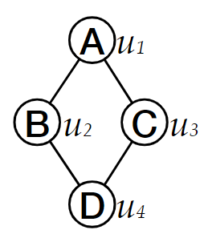
Action Probability
With the state and corresponding action space.
The key problem is to compute the probabilities for each action in the action space.
To this end, we design a Graph Neural Network (GNN)-based policy network.
P=?
P=?

Slide 33
Policy Network
Graph convolutional network:
Action probability with the state at time step t:
Notes:
The performance of our model is not sensitive to the choice of the GNN backbone. In this work, we choose the graph convolutional network. The computation of the GCN in each layer is defined as follows. With the representation hu’ computed by the graph convolutional network, the action probability is computed by a two-layer MLP with a softmax activation function. The mask operation means the selection of vertices in the action space.

Slide 34
Reward Design
Three main rewards:
Enumeration reward
Step-wise validate reward
Entropy reward

Slide 35
Enumeration Reward
The reduced enumeration number:
Enumeration reward:
Notes:
So first I need to introduce the important definition enumeration number. Which, in short, means the number of recursive calls to find all matched with query q , data graph G, order phi and candidate set C. Then the reduced enumeration number is the deduction of enumeration number based on the order produced by RLQVO and that based on the baseline order. We use the order produced by RI as our baseline.
Then the reward is normalized by a function f.

Slide 36
Other rewards
Step-wise validation:
Entropy reward:
Ensure the model can perform more actions.
✔
✔
×

Slide 37
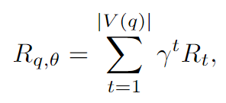
Reward Design
With the aforementioned rewards, our overall rewards at time step t is as follows:
The overall reward is as follows:

Slide 38
Background
Motivation
Framework
Feature Representations
Query Vertex Ordering as Markov Decision Process
Policy Training
Experiments

Slide 39
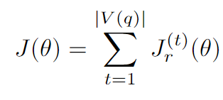
Policy Training
In this work, we use the proximal policy optimization (PPO) to train our policy network with the following loss function:

Slide 40
Background
Motivation
Framework
Feature Representations
Query Vertex Ordering as Markov Decision Process
Policy Training
Experiments

Slide 41
Experiment Setup
Dataset Statistics
Compared methods:
QuickSI
RI
VF2++
VEQ
Hybrid
RL-QVO
Dataset | $$|V|$$ | $$|E|$$ | $$|L|$$ | d
Citeseer | 3,327 | 4,732 | 6 | 1.4
Yeast | 3,112 | 12,519 | 71 | 8.0
DBLP | 317,080 | 1,049,866 | 15 | 6.6
Youtube | 1,134,890 | 2,987,624 | 25 | 5.3
Wordnet | 76,853 | 120,399 | 5 | 3.1
EU2005 | 862,664 | 16,138,468 | 40 | 37.4

Slide 42
Evaluation Metrics
Query processing time
Enumeration time

Slide 43
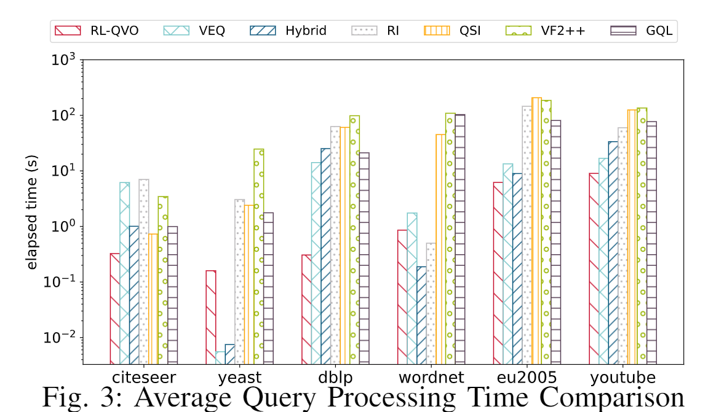
Average Query Processing Time

Slide 44
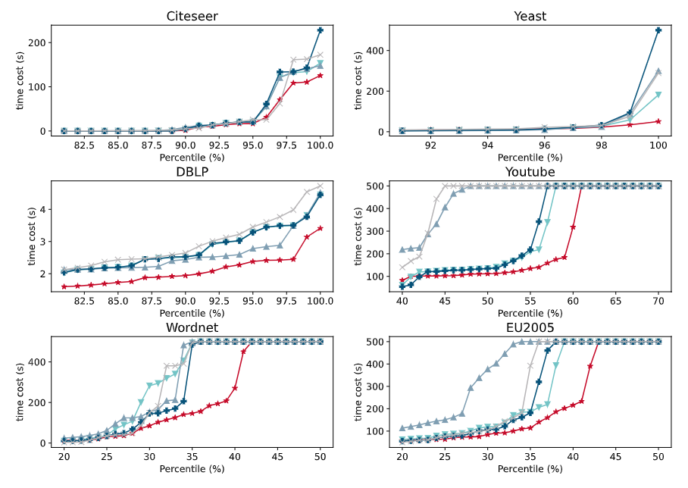
Query Processing Time Percentile Comparison

Slide 45
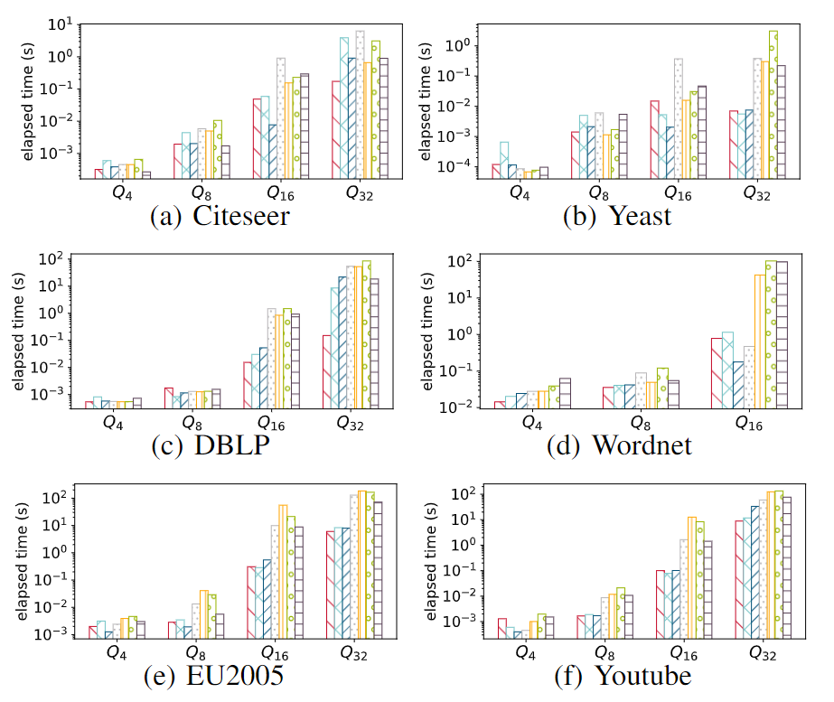
Enumeration Time Comparison

Slide 46
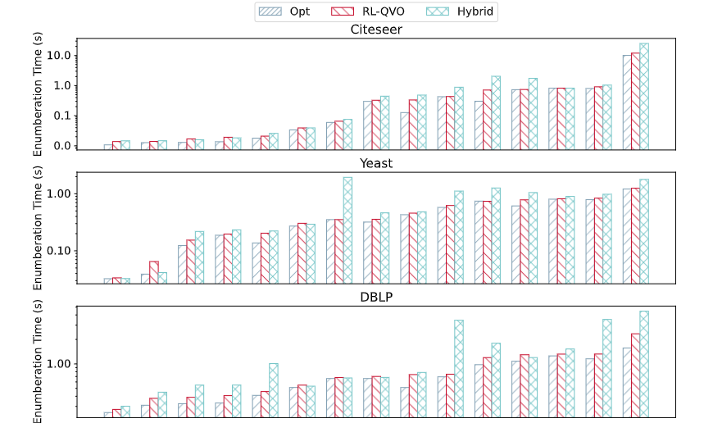
Spectrum Analysis on Enumeration

Slide 47
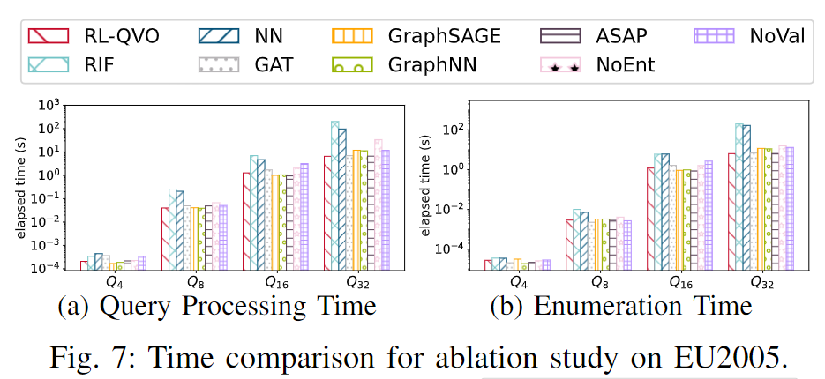
Ablation Study

Slide 48
Misc. Analysis
Parameter analysis;
Varying number of layers;
Varying number of matches;
Please refer to our paper for more details.

Slide 49
Thank You!

